Slide 1
STUDENT PORTFOLIO
STUDENT NAME : CHANDRU S.
REGISTER NO AND NM-ID :asanm225anm22524132251802521006.
DEPARTMENT : B.Sc.,COMPUTER SCIENCE.
COLLEGE : GOVERNMENT ARTS AND SCIENCE COLLEGE,VANUR.
THIRUCHITTRAMPALAM KOOTROAD.
(ANNAMALAI UNIVERSITY.)

Slide 2
PROJECT TITLE
Student Portfoilo

Slide 3
AGENDA
Problem Statement
Project Overview
End Users
Tools and Technologies
Portfolio design and Layout
Features and Functionality
Results and Screenshots
Conclusion
Github Link

Slide 4
PROBLEM STATEMENT
Traditional resumes are static and limited.
They cannot showcase live projects, screenshots, or interactive content.
A digital portfolio provides a dynamic platform for presenting achievements.

Slide 5
PROJECT OVERVIEW
A responsive digital portfolio website created to showcase academics, skills, and projects.
It highlights personal interests, social links, and achievements in a modern and structured format.

Slide 6
END USERS
• Recruiters/Employers – to review skills and projects
• Professors – to verify academic performance.
• Students & Peers – for collaboration and knowledge sharing
• Mentors – to provide feedback and guidance

Slide 7
TOOLS AND TECHINQUES
1. HTML5, CSS3, JavaScript – Frontend design.
2. Python Flask – Backend support (optional).
3. Git & GitHub – Version control & hosting.
4. Canva/Figma – Design mockups and layout ideas.

Slide 8
_{PORTFOLIO DESIGN AND LAYOUT}
Dark theme with glowing highlights.
Profile photo and introduction section.
About section with academic details and hobbies.
Social media and contact links.
Simple and responsive layout.

Slide 9
FEATURES AND FUNTIONALITY
Responsive design (mobile & desktop friendly).
Navigation bar with smooth links.
Profile photo with glowing effect.
Contact information with email, phone, and Instagram links.
Footer with copyright details.

Slide 10
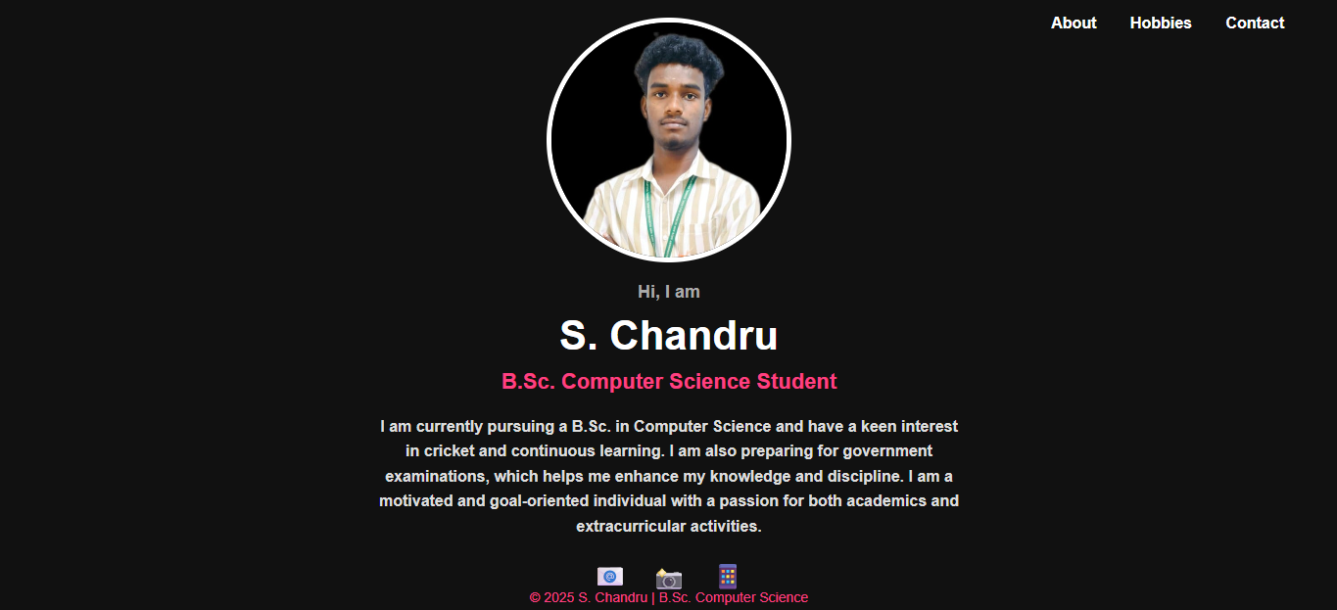
RESULTS AND SCREENSHOTS

Slide 11
GITHUB LINK
https://github.com/chandrus-1208/student-portfolio

Slide 12
CONCLUSION
The Student Portfolio project effectively bridges the gap between a static resume and an interactive digital profile.
It improves visibility for recruiters, professors, and peers while reflecting both academic and personal interests.

